Slide 1
Project overview & Data
GOAL → To examine London Borough dataset and find out price hike ratio with in 20 years.

Slide 2
Stage 1
Sourcing & loading
we found the data set from London Government website and imported the data in a Excel Format.

Slide 3
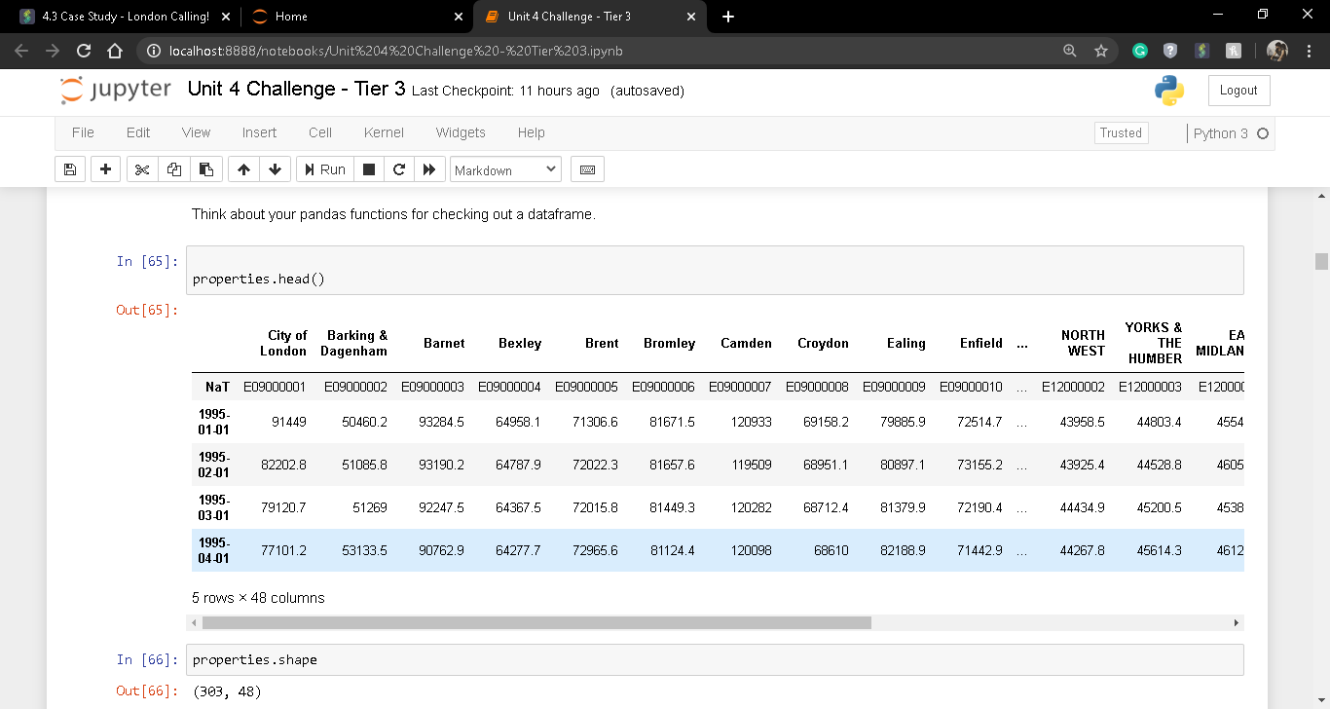
The primary dataset looks like this-

Slide 4
Stage 2
Problems→ We can observe that the dataset is in a unshaped manner.
We need to apply some cleaning to get a better view of the dataset and overcome the problems like→
Transpose the data set.
Reset the index of the dataset.
Melting the dataset by id and borough names.
Removing NaN values from the dataset.
Keeping only unique Boroughs.

Slide 5
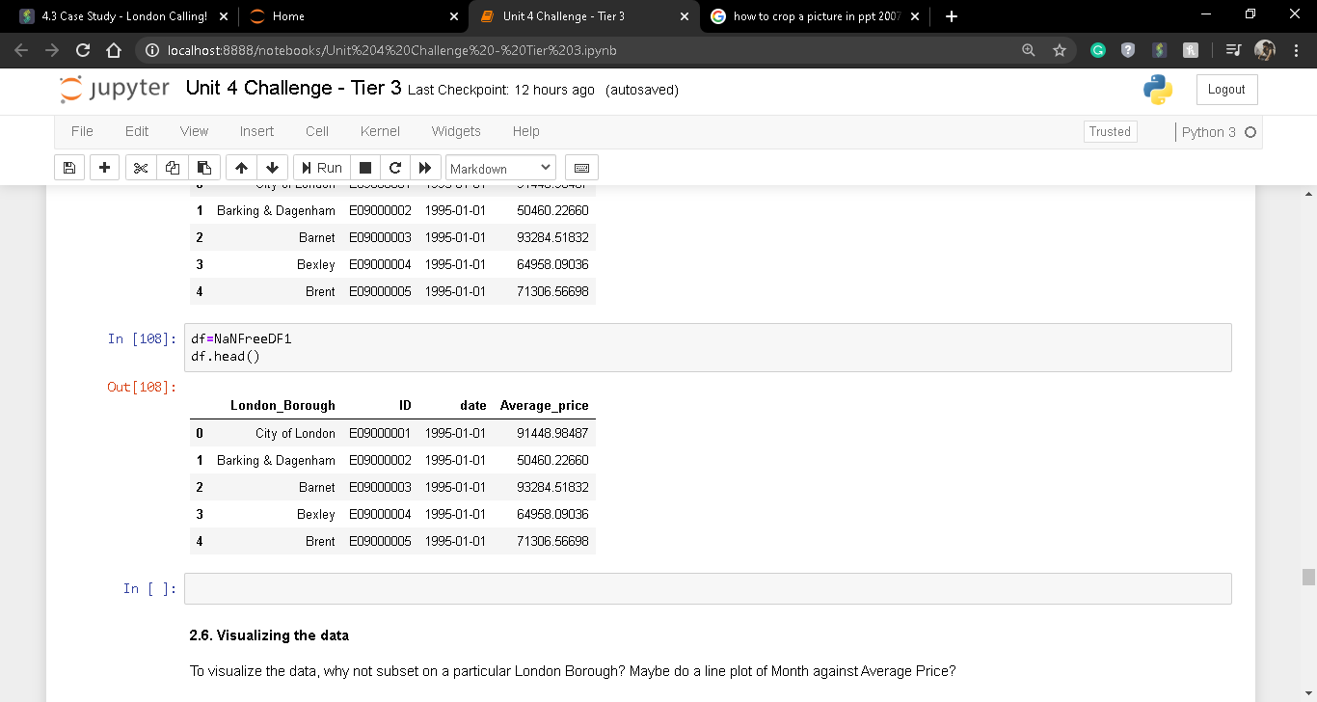
The transformed dataset looks like this→

Slide 6
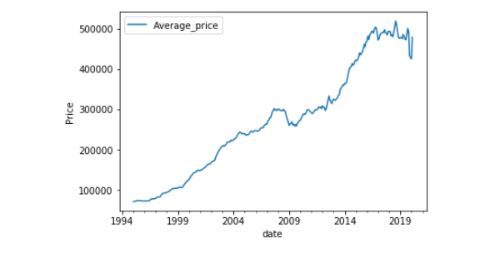
Visualization of average price hike over the years(Brenet)

Slide 7
As we can see price is increased with the years.
Now to get the ratio increased of average price of the cities we nee to extract years from the date based on that we need to get the ratio(1998-2018).

Slide 8
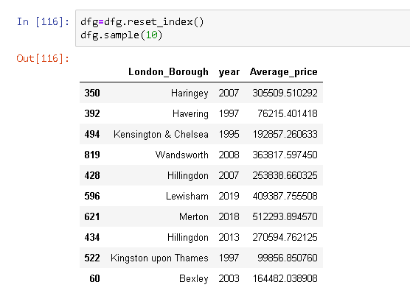
Dataset with Borogh names,year and Price

Slide 9
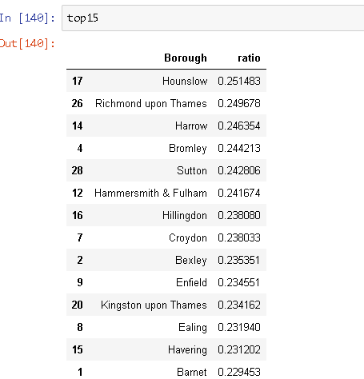
Stage 3 Calculation of price increase ratio(1998-2018)

Slide 10
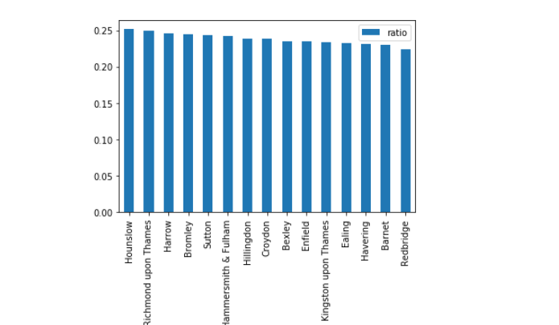
With visualization we can see the top ratio increased Boroughs

Slide 11
Conclusion & Finding
After exploring the data set and comparing the price of 1998 and 2018 we can come to a conclusion that the average price of London Borough has increased over the years and the highest increase is observed in Hounslow with 25% if price increment.
By digging deeper we can see that the top 15 Borough has gone through price increment of minimum 20% or higher.

Slide 12
Thank YOU

